Slide 1
Inferring Causality with Observational Data
Matt Goldman

Slide 2
Prediction
Make a forecast, leaving the world as it is
vs.
Causation
Anticipate what will happen when you make a change in the world

Slide 3
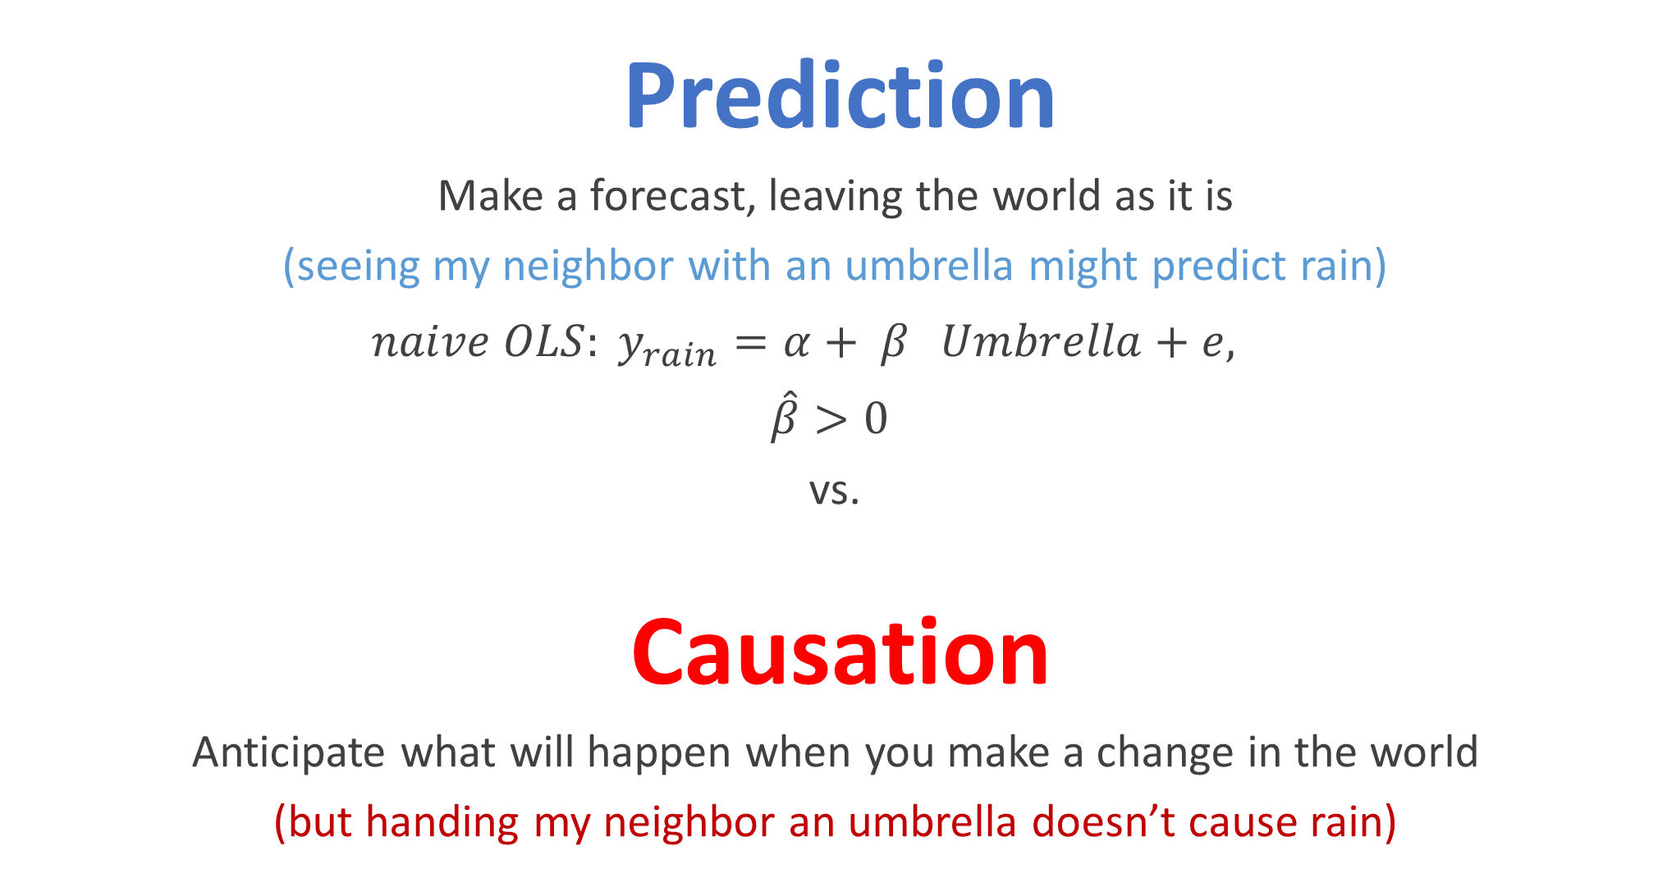
Prediction
Make a forecast, leaving the world as it is
(seeing my neighbor with an umbrella might predict rain)
$naive OLS: y_{rain}=α+ β_{}Umbrella+e,$
$\hat{β}>0$
vs.
Causation
Anticipate what will happen when you make a change in the world
(but handing my neighbor an umbrella doesn’t cause rain)

Slide 4
This is an especially big problem when doing policy analysis. Why?
Policy (umbrellas) are often chosen because of concerns about the exact outcome (rain) we are measuring.

Slide 5
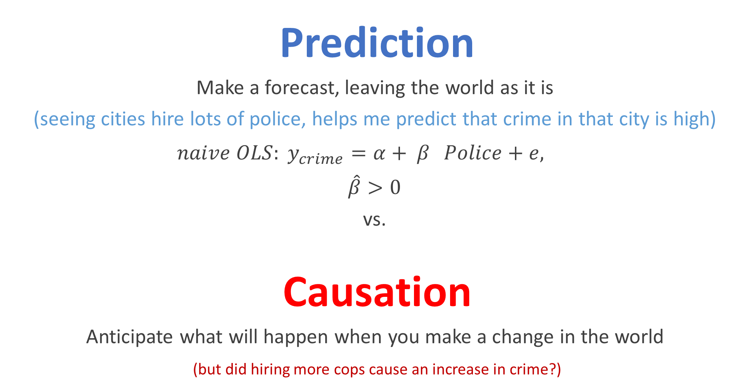
Prediction
Make a forecast, leaving the world as it is
(seeing cities hire lots of police, helps me predict that crime in that city is high)
${naive OLS: y}_{crime}=α+ β_{}Police+e,$
$\hat{β}>0$
vs.
Causation
Anticipate what will happen when you make a change in the world
(but did hiring more cops cause an increase in crime?)

Slide 6
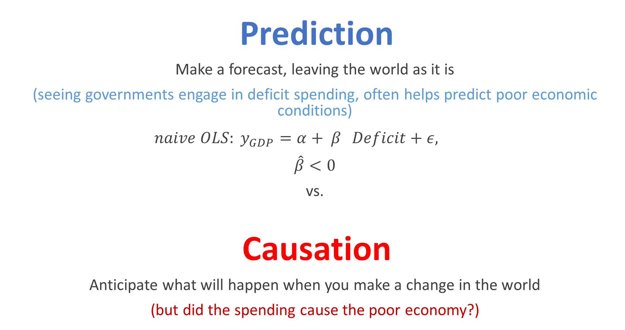
Prediction
Make a forecast, leaving the world as it is
(seeing governments engage in deficit spending, often helps predict poor economic conditions)
${naive OLS: y}_{GDP}=α+ β_{}Deficit+ε,$
$\hat{β}<0$
vs.
Causation
Anticipate what will happen when you make a change in the world
(but did the spending cause the poor economy?)

Slide 7
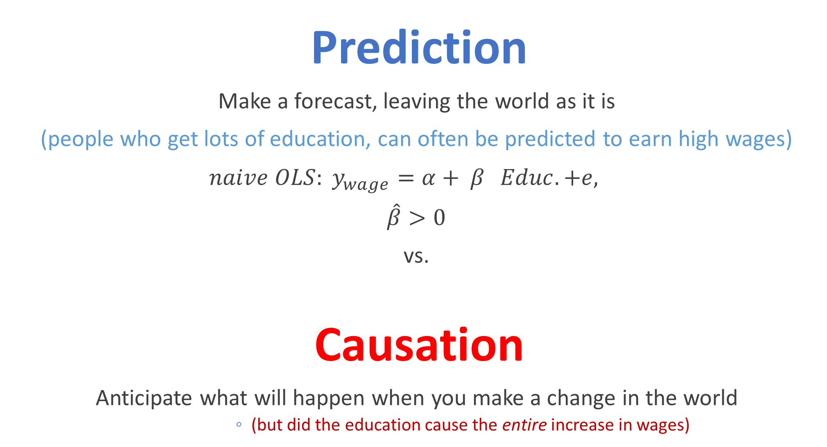
Prediction
Make a forecast, leaving the world as it is
(people who get lots of education, can often be predicted to earn high wages)
${naive OLS: y}_{wage}=α+ β_{}Educ.+e,$
$\hat{β}>0$
vs.
Causation
Anticipate what will happen when you make a change in the world
(but did the education cause the entire increase in wages)

Slide 8
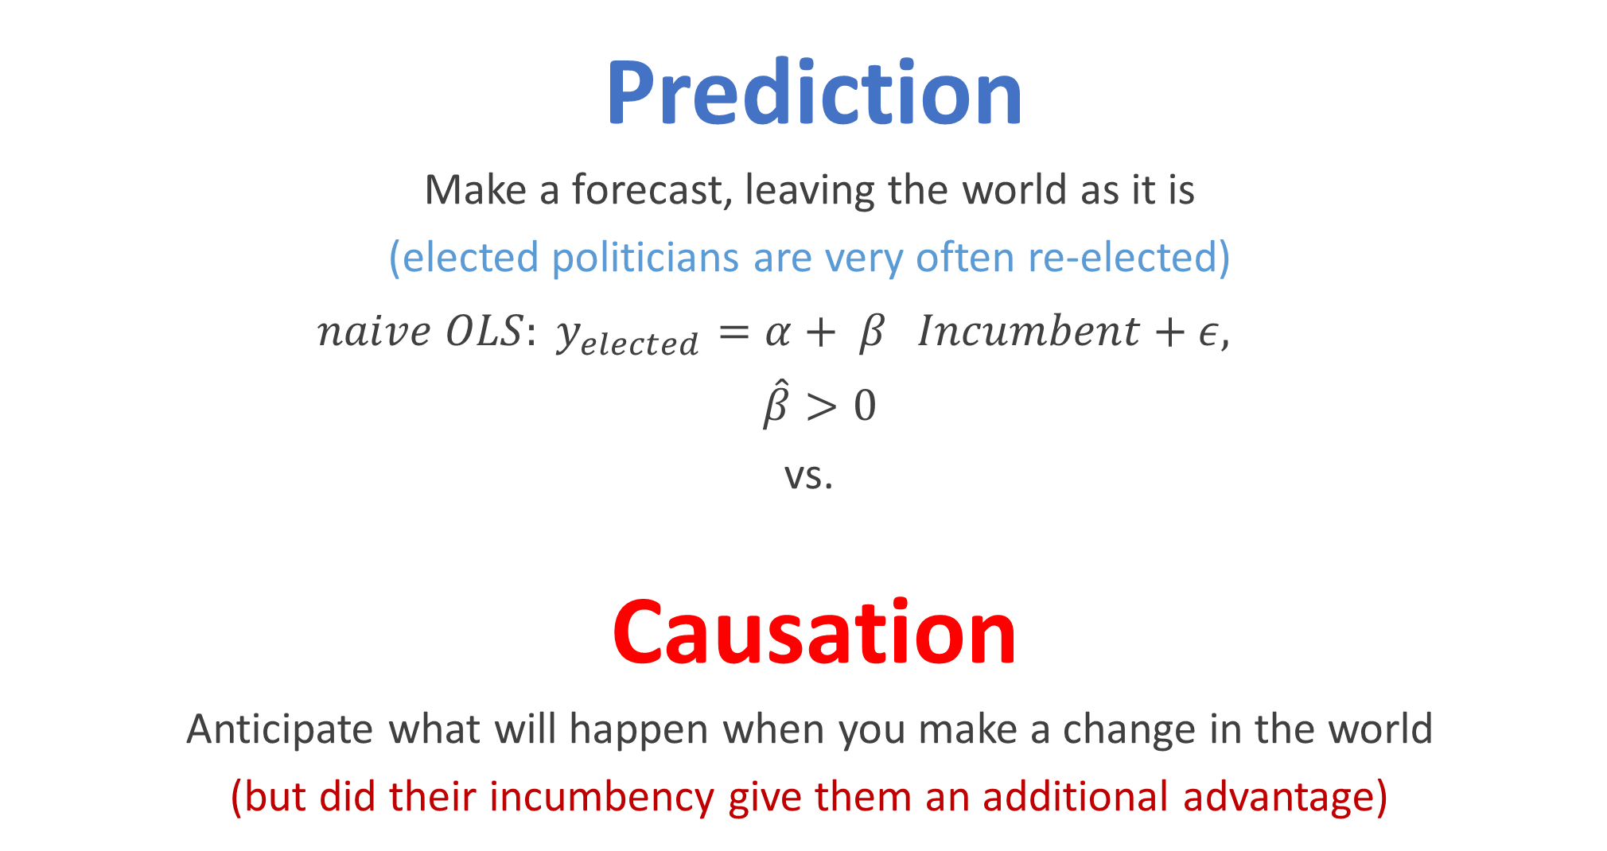
Prediction
Make a forecast, leaving the world as it is
(elected politicians are very often re-elected)
${naive OLS: y}_{elected}=α+ β_{}Incumbent+ε,$
$\hat{β}>0$
vs.
Causation
Anticipate what will happen when you make a change in the world
(but did their incumbency give them an additional advantage)

Slide 9
Measuring Causality: Two Strategies
Run an experiment:
Experimentation is always the gold standard of causal inference.
Getting cities/states/countries/firms to randomize policy is often hard.
Find a natural experiment:
Finding “experiment like” variation in a treatment of interest.
Economists call this: finding a natural experiment.

Slide 10
Natural Experiments

Slide 11
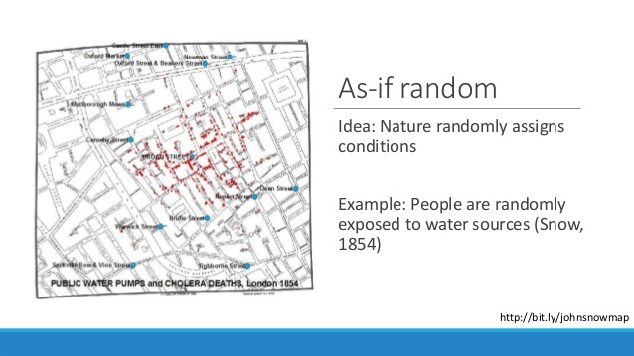

Slide 12
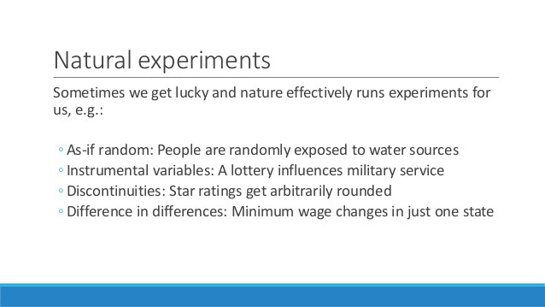

Slide 13
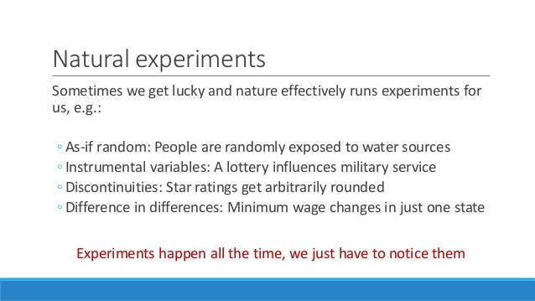

Slide 14
Do I have a Natural Experiment?
Natural experiments occur when variation in your treatment is independent of any other shocks that impact your outcome.
Typically, you can not test for this criteria in your data. You have to combine critical thinking with intuition about the setting of your study to decide if you have a natural experiment.

Slide 15
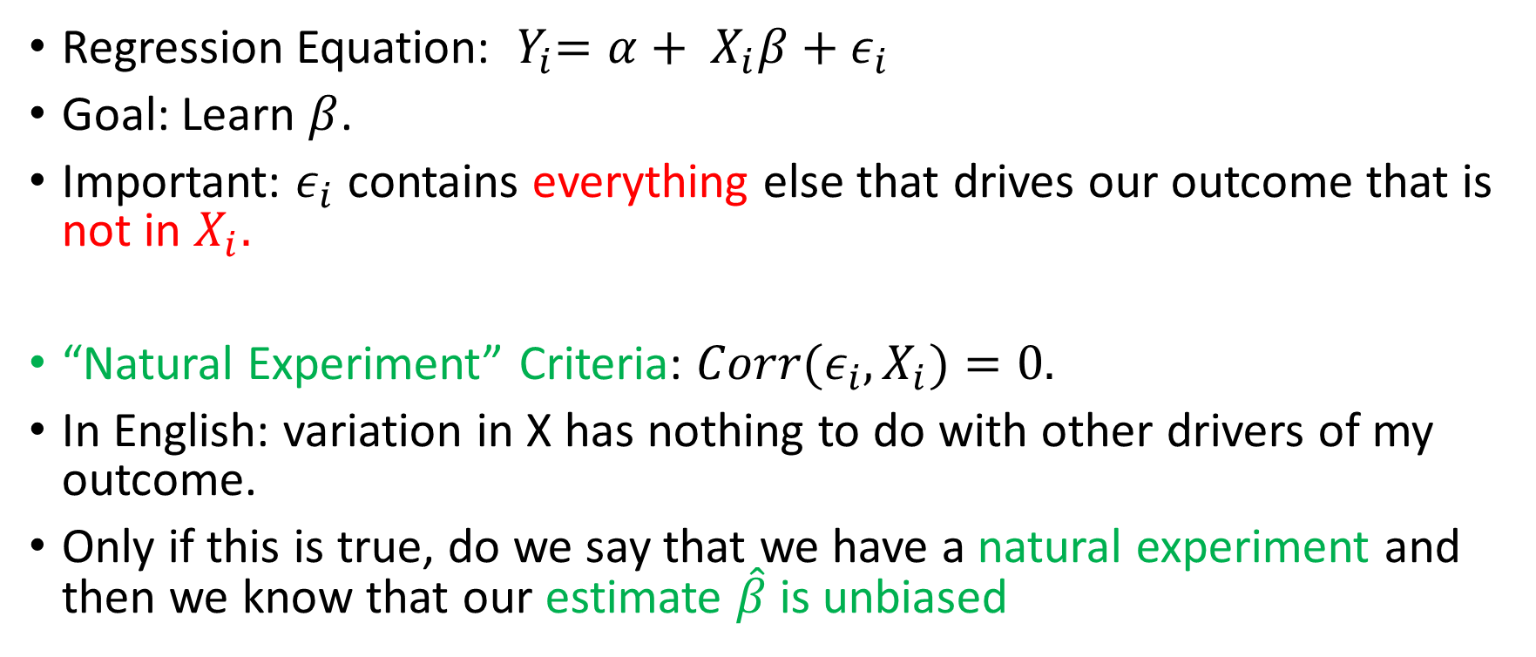
The “Natural Experiment” Criteria
Regression Equation: ${ Y}_{i}=α+ X_{i}β+ε_{i}$
Goal: Learn $β$.
Important: $ε_{i}$ contains everything else that drives our outcome that is not in $X_{i}.$
“Natural Experiment” Criteria: ${Corr(ε}_{i},X_{i})=0.$
In English: variation in X has nothing to do with other drivers of my outcome.
Only if this is true, do we say that we have a natural experiment and then we know that our estimate $\hat{β}$ is unbiased

Slide 16
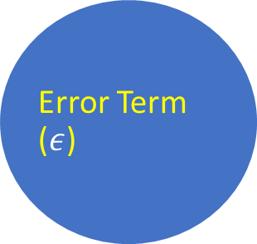
Graphical Depiction of “Natural Experiment” Criteria
Treatment (X)
Outcome (Y)
Treatment may cause the outcome
Error Term ($ε$)
Notes:
example insight from book
airlines leading example

Slide 17
Graphical Depiction of “Natural Experiment” Criteria
Treatment (X)
Outcome (Y)
Error Term ($ε$)
Other unobserved things (error term) can cause Y
Notes:
example insight from book
airlines leading example

Slide 18
Graphical Depiction of “Natural Experiment” Criteria
Treatment (X)
Outcome (Y)
Error Term ($ε$)
Treatment selection can not be caused by the error term
Notes:
example insight from book
airlines leading example

Slide 19

Graphical Depiction of “Natural Experiment” Criteria
Treatment (X)
Outcome (Y)
Error Term ($ε$)
The error term can not be caused by treatment selection
Notes:
example insight from book
airlines leading example

Slide 20
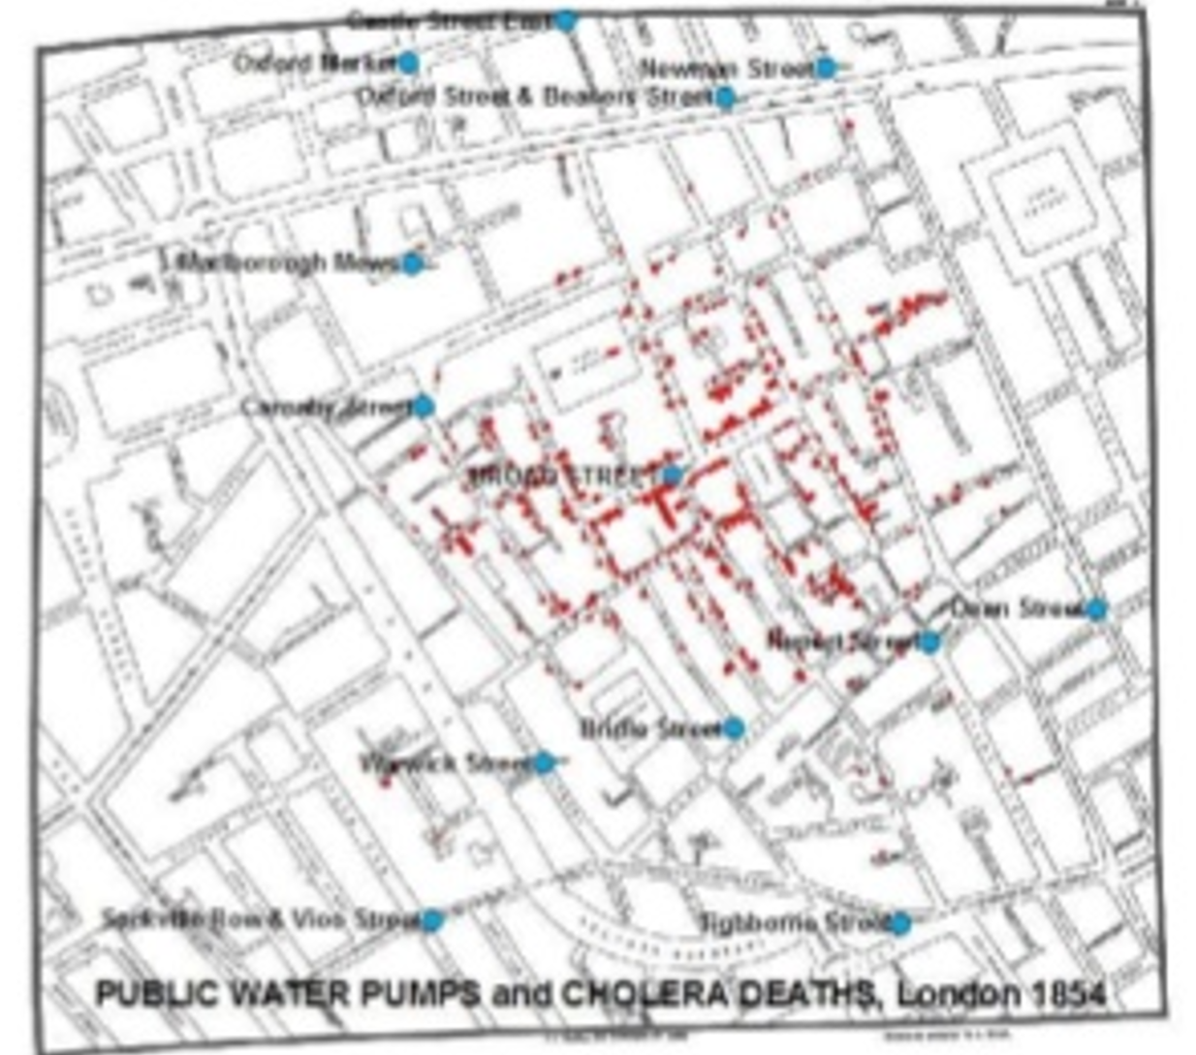
Is Living Near a Public Water Pump A Natural Experiment?
That depends. Are residual factors causing cholera (epsilon) correlated with living near a water pump (treatment).
Important factors to consider:
Where are water pumps placed?
What kinds of people live in those neighborhoods?
What kinds of people are naturally more prone to getting cholera?

Slide 21
Using Control Variables in a Regression

Slide 22
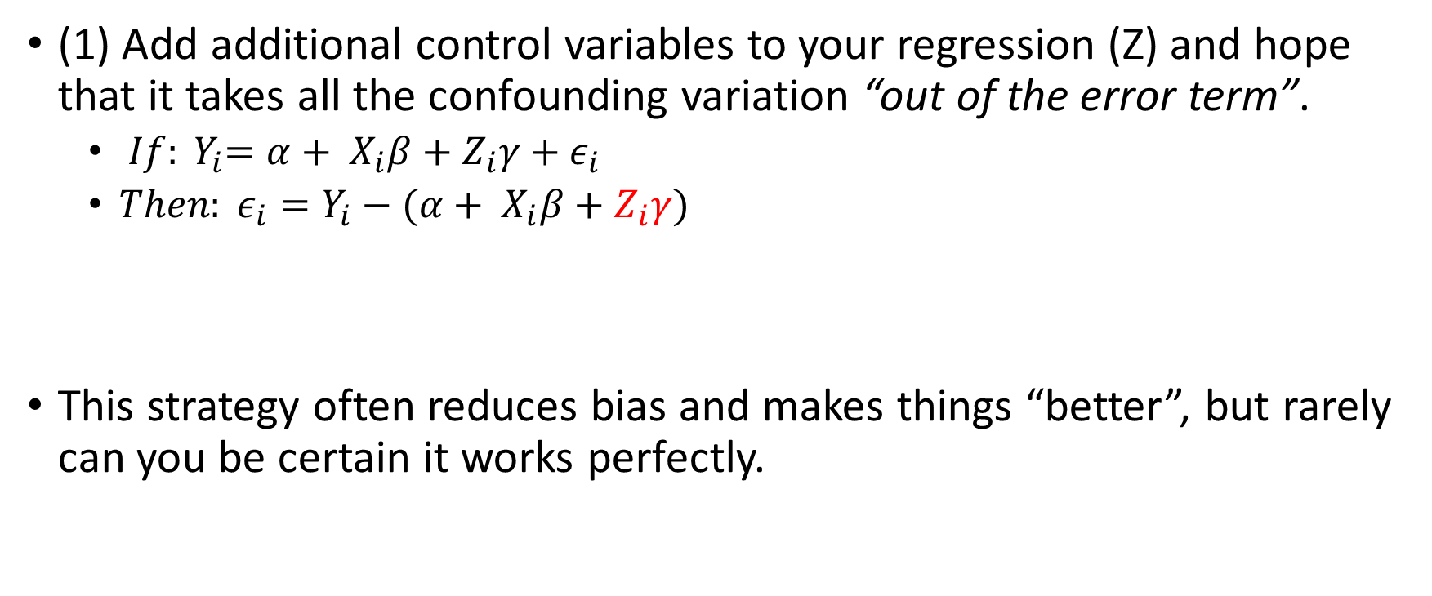
Getting Closer to a Natural Experiment with Controls (Z)
(1) Add additional control variables to your regression (Z) and hope that it takes all the confounding variation “out of the error term”.
${ If: Y}_{i}=α+ X_{i}β+Z_{i}γ+ε_{i}$
${{Then: ε}_{i}=Y}_{i}−(α+ X_{i}β+Z_{i}γ)$
This strategy often reduces bias and makes things “better”, but rarely can you be certain it works perfectly.

Slide 23
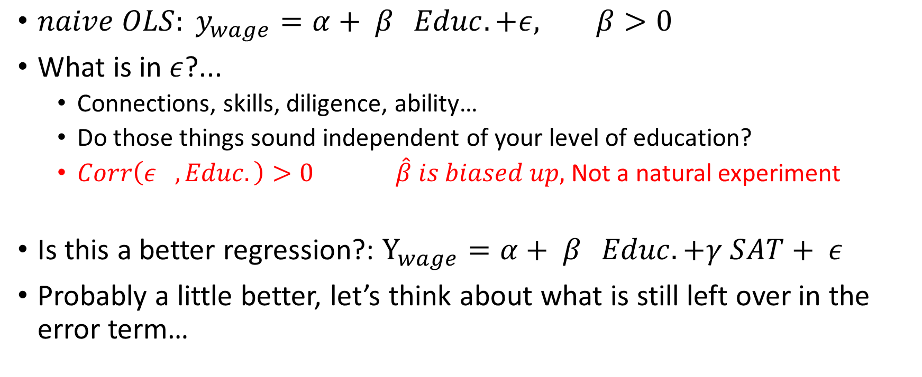
For Example (Returns to Education)….
${naive OLS: y}_{wage}=α+ β_{}Educ.+ε, β>0$
What is in $ε$?...
Connections, skills, diligence, ability…
Do those things sound independent of your level of education?
$Corr\left(ε_{}, Educ.\right)>0 \hat{β} is biased up,$Not a natural experiment
Is this a better regression?: $Y_{wage}=α+ β_{}Educ.+γ SAT+ ε$
Probably a little better, let’s think about what is still left over in the error term…

Slide 24
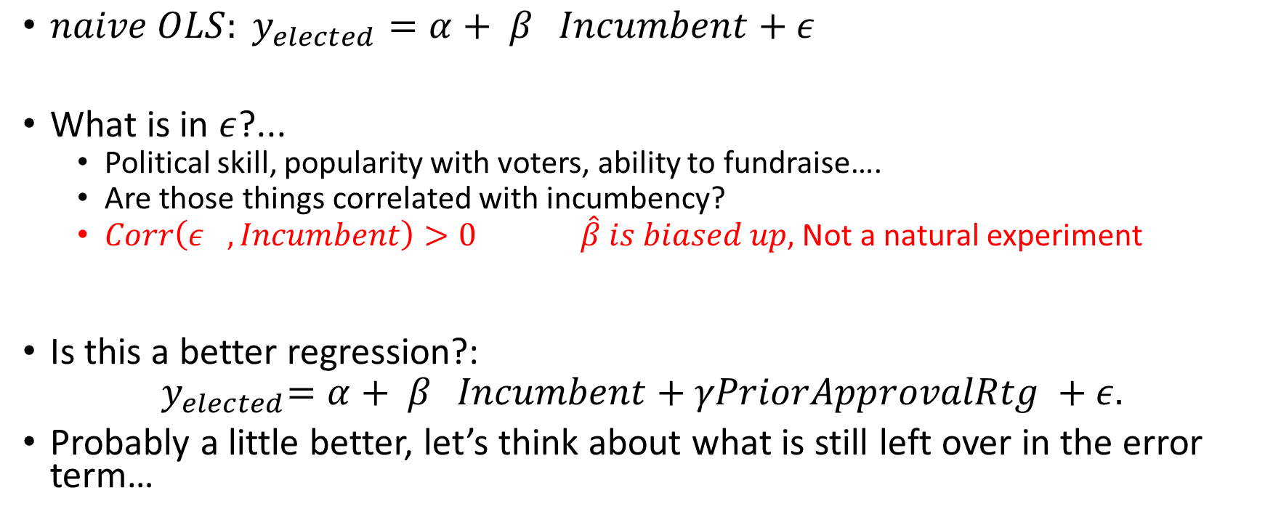
For Example (Incumbency)….
${naive OLS: y}_{elected}=α+ β_{}Incumbent+ε$
What is in $ε$?...
Political skill, popularity with voters, ability to fundraise….
Are those things correlated with incumbency?
$Corr\left(ε_{},Incumbent\right)>0 \hat{β} is biased up,$Not a natural experiment
Is this a better regression?:
$${ y}_{elected}=α+ β_{}Incumbent+γPriorApprovalRtg +ε.$$
Probably a little better, let’s think about what is still left over in the error term…

Slide 25
Goal: Pick Control Variables so that you get closer to a “natural experiment”

Slide 26
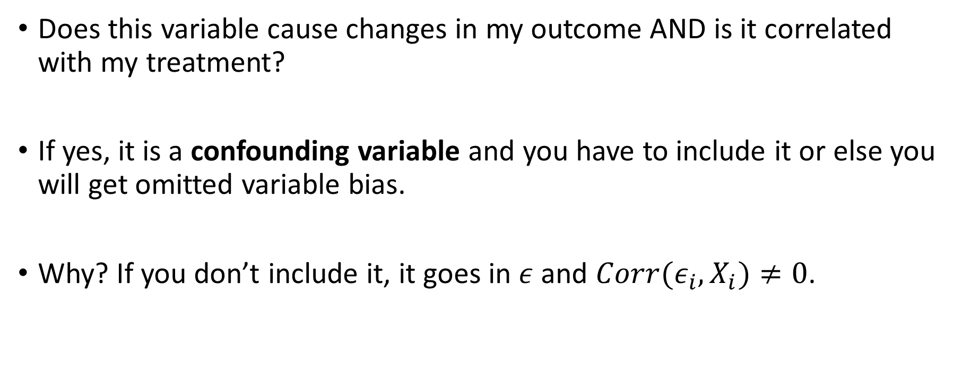
Picking Controls: Confounding Variable
Does this variable cause changes in my outcome AND is it correlated with my treatment?
If yes, it is a confounding variable and you have to include it or else you will get omitted variable bias.
Why? If you don’t include it, it goes in $ε$ and ${Corr(ε}_{i},X_{i})≠0$.

Slide 27
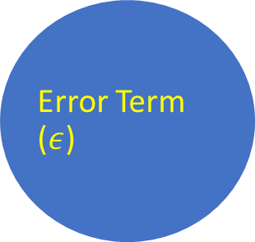
Graphical Depiction of Confounding Variables
Outcome (Y)
This is okay because we observe and control for the confounding variable by putting it in the regression!
Treatment (X)
Confounding Variable (Z)
Error Term ($ε$)
Notes:
example insight from book
airlines leading example

Slide 28
Graphical Depiction of Confounding Variables
Outcome (Y)
This is okay because we observe and control for the confounding variable by putting it in the regression!
But what happens if we remove the confounding variable from our regression?
Treatment (X)
Confounding Variable (Z)
Error Term ($ε$)
Notes:
example insight from book
airlines leading example

Slide 29
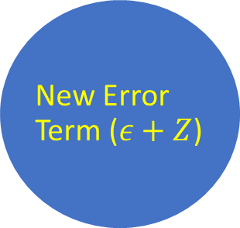
Graphical Depiction of Confounding Variables
This is okay because we observe and control for the confounding variable by putting it in the regression!
But what happens if we remove the confounding variable from our regression?
It goes into the error term. Not ok!
Treatment (X)
Outcome (Y)
New Error Term ($ε+Z$)
Notes:
example insight from book
airlines leading example

Slide 30
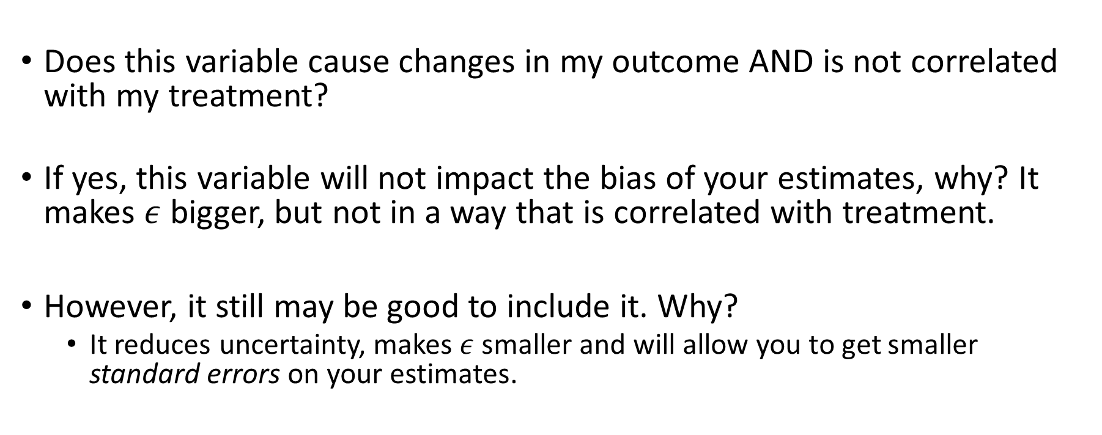
Picking Controls: Variance-Reducing Variables
Does this variable cause changes in my outcome AND is not correlated with my treatment?
If yes, this variable will not impact the bias of your estimates, why? It makes $ε$ bigger, but not in a way that is correlated with treatment.
However, it still may be good to include it. Why?
It reduces uncertainty, makes $ε$ smaller and will allow you to get smaller standard errors on your estimates.

Slide 31
Picking Controls: Unrelated Variables
Does this variable not cause changes in my outcome?
If yes, this variable will not be helpful to your regression. It will just induce a little bit of overfitting and you should drop it.
If a control variable has a statistically insignificant t-stat (|t|<1.96), you can conclude that it is unrelated and should usually drop it from your regression.

Slide 32
Picking Controls: “Bad Controls”
Is this variable caused by my treatment of interest?
If yes: I absolutely can NOT include it in my regression. Ignore all other considerations and drop it from the regression.
Why? It might be obscuring the treatment effect (if that effect is channeled through the “bad control”)
Good rule of thumb: any variable which is not determined until after the intervention/treatment takes place is probably a “bad control”.

Slide 33
Summary
It is a catastrophe if you don’t include: Confounding Variables.
It is good to include: Variance-Reducing Variables
It is a waste to include: Unrelated variables.
It is a catastrophe if you do include: Bad Controls

Slide 34
Ex.: Returns to College Education
You must include Confounding Variables:
Ex: Parent’s Education, Parent’s Income, Geographic Controls, # Siblings, High-school GPA, SAT score…
It is good to include: Variance-Reducing Variables
Ex: Economic conditions the year you graduate college
It is a waste to include: Unrelated variables.
Student’s favorite NBA player, student’s astrological sign, whether or not student owns exactly 8 pairs of pants
It is a catastrophe if you include: Bad Controls.
Ex: Number of LinkedIn Connections after college, where student lives after college, other wage data from after college

Slide 35
Research Design: Difference in Differences (DiD)

Slide 36
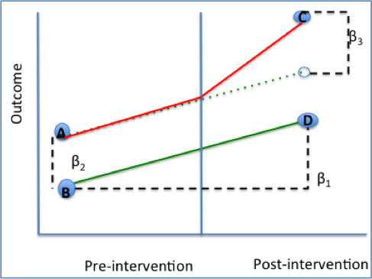
Difference in Differences
Common strategy for exploiting sudden policy changes.
Basic idea:
Focus analysis only on a treatment group that was exposed to a policy change and a control group that was not.
Compare the pre-post trend for these two groups. Attribute any difference in trends to the impact of the treatment.
Key Assumption: “Parallel trends”

Slide 37
Parallel Trends Assumption (What would Have Happened if No Treatment?)
Not enrolled
Y₁ | G_{i}=0
Y₀ | G_{i}=0
Enrolled
Y₁ | G_{i}=1
Y₀ | G_{i}=1
Outcome Variable
T=0
T=1
Time

Slide 38
Impact of Treatment (Graphical Depiction)
Not enrolled
Y₁ | G_{i}=0
Outcome Variable
Y₀ | G_{i}=0
Y₁ | G_{i}=1
Enrolled
Estimated Treatment Effect
Y₀ | G_{i}=1
Only data point to get intervention
T=0
T=1
Time

Slide 39
Box Depiction (“The difference between differences”)
 | Group affected by the policy change (treatment group) | Group that is not affected by the policy change (control group)
After the program start | Y₁ | G_{i}=1 | Y₁ | G_{i}=0
Before the program start | Y ₀ | G_{i}=1 | Y₀ | G_{i}=0
“Diff” | (Y₁|G=1)-(Y₀|G=1) | (Y₁|G=0)-(Y₀|G=0)
Only cell to get intervention
“Diff in Diffs”:
DD=[(Y₁|G=1)-(Y₀|G=1)] - [(Y₁|G=0)-(Y₀|G=0)]

Slide 40
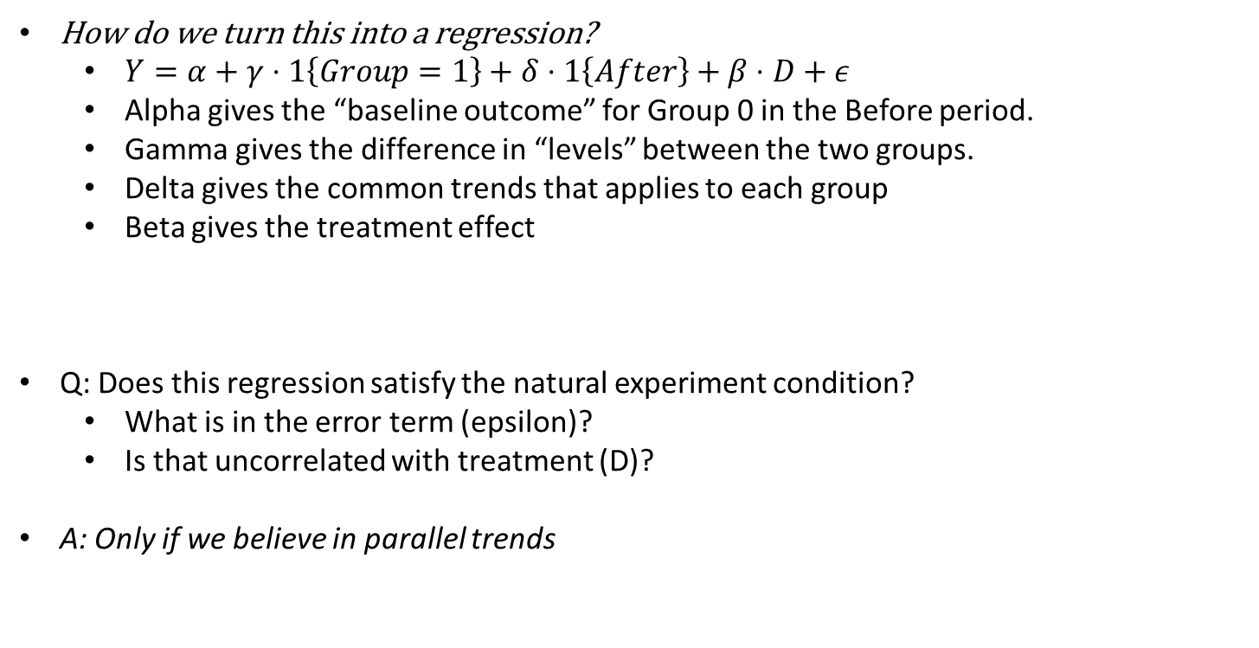
Regression
How do we turn this into a regression?
$Y=α+γ⋅1\left\{Group=1\right\}+δ⋅1\left\{After\right\}+β⋅D+ε$
Alpha gives the “baseline outcome” for Group 0 in the Before period.
Gamma gives the difference in “levels” between the two groups.
Delta gives the common trends that applies to each group
Beta gives the treatment effect
Q: Does this regression satisfy the natural experiment condition?
What is in the error term (epsilon)?
Is that uncorrelated with treatment (D)?
A: Only if we believe in parallel trends

Slide 41
Should we Believe DiD designs?
Only if we believe in the “parallel trends” assumption. That is: Any difference in the “natural trend” of our two groups shows up in our error term and is certainly correlated with treatment.
Graphically: We should only believe DiD if we thought the red and the green lines would have had the same slope in the absence of the intervention.
$$Y=α+γ⋅1\left\{Group=1\right\}+δ⋅1\left\{After\right\}+β⋅D+ε$$

Slide 42
When do researchers use DiD?
When a big event (e.g. natural disaster, passage of new law) impacts one region/country/state, but not a nearby region.
Researcher is concerned that a simple diff might be contaminated by other things changing in the treated region.
Researcher believes time-varying shocks are the same in a nearby control region (“parallel trends”).
Famous example: Impact of new minimum wage laws on New Jersey. Use Pennsylvania (no law change) as control (Card and Krueger, 1994).

